Slide 1


Time to Failure Prediction Group P6A
Shengxin (Christine) Ding
Jishi Liu
Bofu Zhang
Ting Zhang
Xiyu (Tracy) Zhang
Notes:
Hello everyone, we are MS in Business Analytics students from simon business school to present our study on predicting time to failure of Xerox product. I am Bofu, this is my team member…

Slide 2
Agenda
3. Data cleaning &
Feature Engineering
9. Recommendations
7. Model Performance
5. Survival Analysis
1. Introduction
4. Final Dataset
8. Demonstration
6. Coefficient Interpretation
2. Raw Dataset
Notes:
Here is our agenda. Firstly we will briefly introduce the background of the project and the raw dataset provided by Xerox team.
Then we would like to start with talking about our data cleaning and feature engineering on the raw dataset. Afterwards, we are going to show the final dataset we were working on.
After that, we will present our model – survival analysis and then further interpret its results so that we could understand what factors determine the products’ failure/survival time.
Then, we will talk about our model performance. Here we built 2 models based on different feature selection approaches. We will also demonstrate how to use these 2 models to predict. Finally, we will discuss our recommendations on future improvement of the project.

Slide 3
Introduction
Xerox is managing over 1.5 million printing devices for customers by collecting IoT data about devices’ characteristics, utilization, failure incidents.
Predict probability of device failure
Model-based data
Asset-based data
Act promptly and preemptively
Improve customer service
Notes:
According to the project information provided by Xerox team. Xerox is now managing over 1.5 million printing devices for customers. Xerox is also collecting the devices’ data through Internet of Thing about the devices’ characteristics, utilization, and failure incidents. Therefore, it is worthwhile to dive into the big pool of IoT data and try to see if we can find out some latent pattern of devices’ failure.
So the chart below is a overview big picture of the project: firstly, we get the model-based and asset-based data. The model based refer to what model does the device belongs to. The asset based mainly refer to its individual feature like utilization and age. Given this data, we use our model to predict the probability that the device will failure in the next few days, and act promptly and proactively to cope with the problem, so that we could improve customer service quality.

Slide 4
Raw Dataset
Asset Data - device level information
Volume data – utilization log of devices
Asset-based
Asset ID
Model-based
Model name
Age in month
Model class
Is color
PPM
Color PPM
Is scanner
Is copier
Is fax
Asset ID
Read date
Volume
Incident data – history log of incidents
Asset ID
Date
Problem type
Notes:
We were provided 3 data sets, they were asset data, volume data, and incident data.
Asset data includes both asset-based and model based information, the volume data set has devices’ daily utilization – how many page the devices print.
The incident data set contain information about when and what type of problem happened.

Slide 5
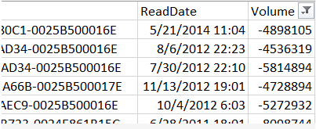
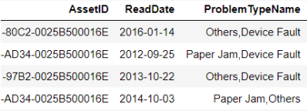
Data Cleaning
Asset Table
Drop Asset ID (no volume):
B69A09A1-EFD4-E211-BA2D-0025B500016E
Volume Table
Big Day-by-day table
Failure Table
Notes:
Here is what we did to clean the data sets.
For asset table, we just drop a Asset ID that doesn’t have any record on the other two tables.
For volume table, we dropped some negative volume
For failure table, we chose two most common problem type – paper jam and device fault, and grouped the other problem type to others.
After that, we merged them to a big, day-by-day table.

Slide 6
Feature Engineering – Age, Volume & Scaling
Set age = 1 (month) at the first record for every machine
Survival Day: cumulative dates since last incident.
We add several new page features that may have effects on the failure probability:
Last 30 Day Volume
Last 15 Day Volume
Last 7 Day Volume
Yesterday Volume
Cumulative Pages Printed
We scale the volume-related features at a 100,000 level
Notes:
We also did feature engineering to make our variable more reasonable. Firstly, we set age = 1 at the first record for every device. In other words, we assume every machine starts to use at the time of first record. We also count dates since last incident to see how many dates the machine survived since last failure. Then we added the following page features that may have effects on the failure probability:
Also, we scale the volume-related feature by 100,000.

Slide 7
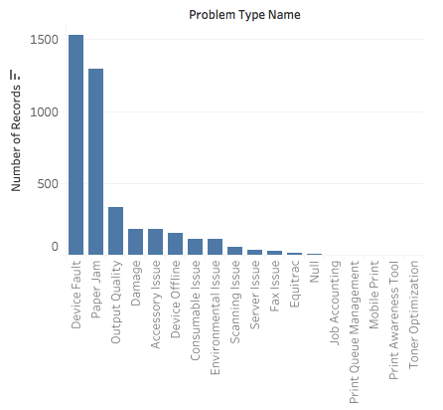
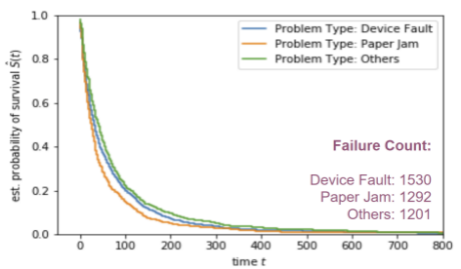
Feature Engineering - Problem Types
Notes:
As I mentioned, we used 3 problem types – device fault, paper jam, and others. But later on, we found out that problem types does not significantly impact the survival probability, as you can see, the three curves are very close to each other. So we decided to treat the 3 problem type as same.

Slide 8
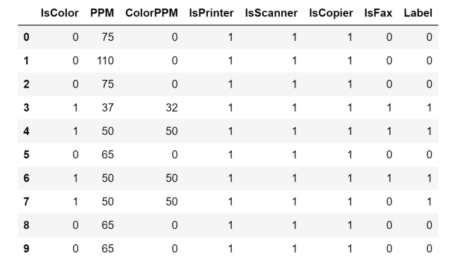
Feature Engineering - K-Means Clustering
Notes:
In order to summarize the model based information, we used K-Means to cluster the devices into 3 new label, 0,1 and 2.

Slide 9
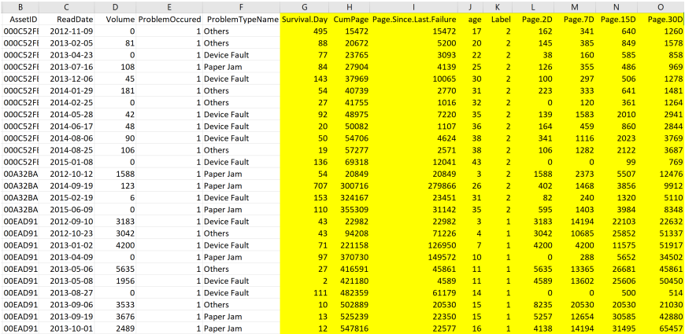
Final Dataset
Notes:
So here is our final dataset used to build our model. The yellow block is our variables. Among these, label is the variable that contains devices’ model based feature and the other variables are individual asset based features.

Slide 10
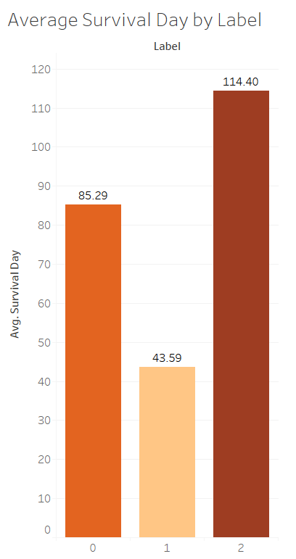
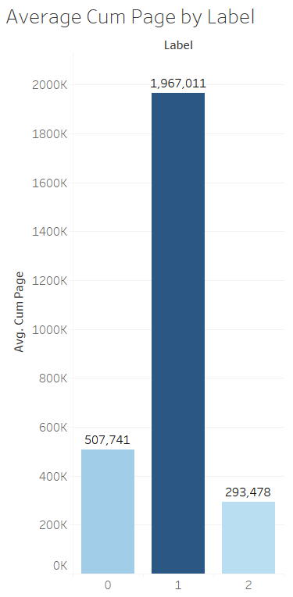
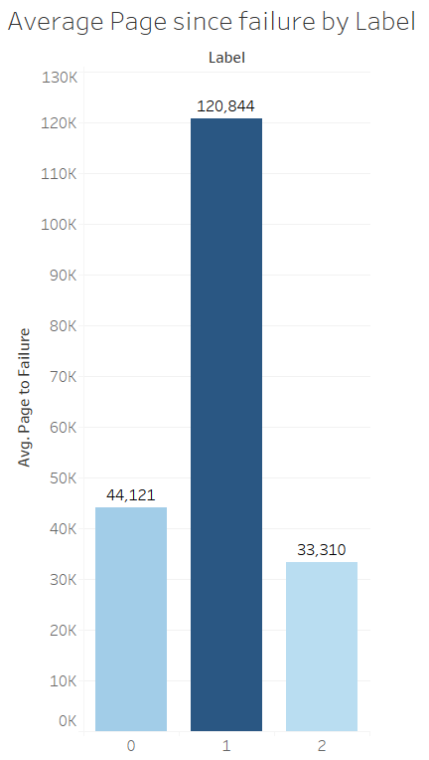
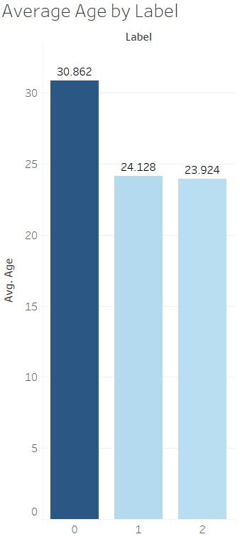
Final Dataset – Statistics

Slide 11

Introduction to Survival Analysis
Statistical methods for analyzing longitudinal data on the occurrence of events
Events may include death, injury, onset of illness, recovery from illness (binary variables) or transition above or below the clinical threshold of a meaningful continuous variable
Estimate time-to-event for a group of individuals
Eg. time until second heart-attack for a group of MI patients
To compare time-to-event between two or more groups
Eg. treated vs. placebo MI patients in a randomized controlled trial
To assess the relationship of co-variables to time-to-event
Eg. does weight, insulin resistance, or cholesterol influence survival time of MI patients?

Slide 12
Introduction to Multivariate Cox Regression
The most popular techniques for survival analysis is Cox proportional hazards regression
The objective is to assess simultaneously the effect of several risk factors on survival time. It allows us to examine how specified factors influence the rate of a particular event happening (e.g., infection, death) at a particular point in time.
The measure of effect is the hazard rate.
Hazard rate: the risk of failure given that the participant has survived up to a specific time

Slide 13
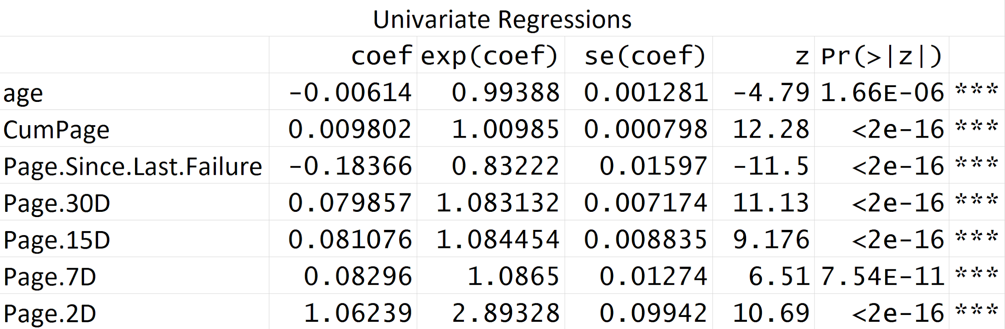
Coefficient interpretation
Obtained from univariate COX regression
Coef sign
Positive: Hazard rate (Failure posibility) increase when variable increase
Negative: Hazard rate (Failure posibility) decrease when variable increase
Exponential of coef
> 1: Hazard rate increase by (exp(coef) - 1) when variable increase 1 unit
< 1: Hazard rate decrease by (1 - exp(coef)) when variable increase 1 unit
Negative coef of Age & Page.Since.Last.Failure:
1. Intervention information
2. Repair data
Variable coefficients summary
Age: in month
Page Variables: in 100,000 pages (if the variable increases by 1 unit, that means the volume increase by 100,000 pages)

Slide 14
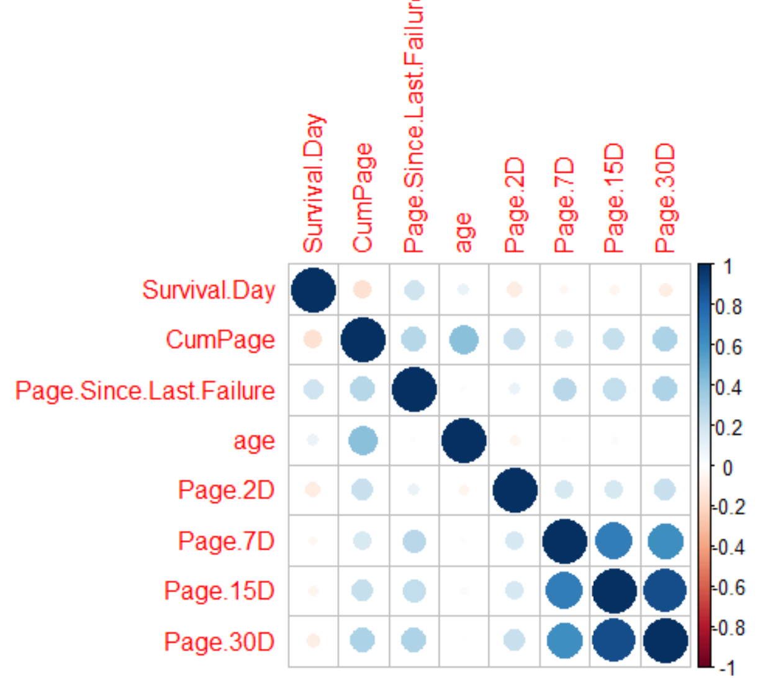
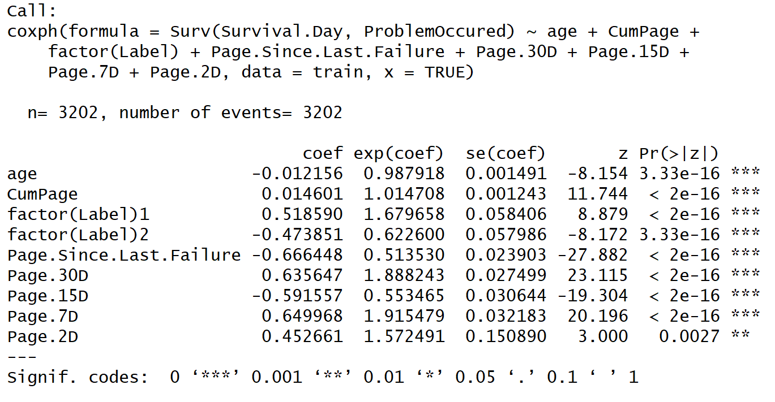
Model 1 - Overview
Cross Validation: 80% to train the model, 20% to test the error rate

Slide 15
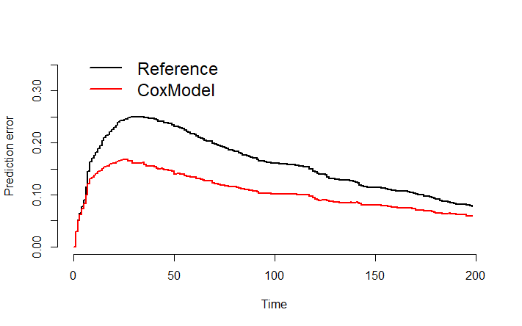
Model 1 - Performance
Basic Survival Model: Day 33, Error rate 0.2499809
Our Cox Model: Day 26, Error rate 0.1689168
B-Score for Error Rate
Brier score (B-Score) is a weighted average of the squared distances between the observed survival status and the predicted survival probability of a model.

Slide 16
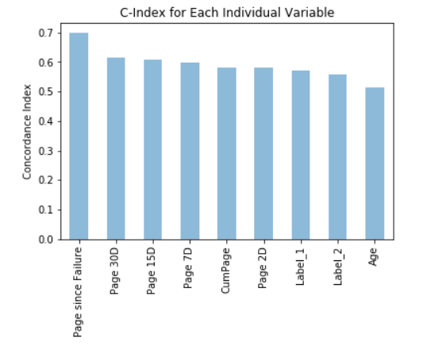
Model 2 - Variable Predictive Performance
Concordance Index (C-Index)
Generalization of the area under ROC curve, called Harrell’s Concordance Index.
Value of 0.5 denotes a random model
Value of 1.0 denotes a perfect model
Value of 0.0 denotes a perfectly wrong model

Slide 17
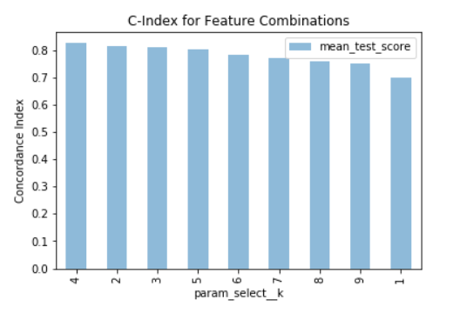
Model 2 - Feature Selection
Use Grid Search with Cross Validation = 5
4 - Feature Combination achieved highest C-Index, and provided the best model
Page Since Failure
30D Page Volume
15D Page Volume
7D Page Volume
Fit best model with whole dataset
C - Index before feature selection: 0.75
C - Index after feature selection: 0.83

Slide 18
Demonstration of Model
Kindly see demonstration in R Studio

Slide 19
Recommendations
1. Explore deeper in survival analysis
2. Collect more data to train the model
3. Include maintenance data in the model
4. Update K-Means cluster labels when adding new asset features
5. Set auto-alarm reminders
Notes:
Based on our model building and evaluation process, we have these 5 recommendations to further develop this project, improve the predictive accuracy of devices incidents, and provide better services to our customers.
and its diversified index. For prediction, we recommend that you use the first model, but the second model is also very intuitive.
Keep the asset, incident and volume data updated everyday. With more data, the accuracy of this predictive model will be higher, and we can create increasingly sophisticated models that can predict failure more accurately.
To fully understand the failure prediction model, it’s important to collet maintenance data, such as the repair history. Imagine a 5-year-old and a 10-year-old car. The 5-year-old car has not been repaired since it was sold, and the 10-year-old car has its main components updated to the newest recently. Which would have a higher failure probability in the next year?
When given the color, PPM, or other features of a new asset, we should rerun the cluster model, and give assets new labels.
to keep track of problematic devices when their failure probabilities approach to a certain threshold. Then we can remind our customers, send out maintenance stuff to give repair support in advance, and prevent failures before they happen. Planned support for devices can significantly reduce asset down-time and costs through careful planning.

Slide 20
Q & A
Thank you
Notes:
This is the sum-up of our presentation.
Thank you for listening.
We will take any questions from now.

